Slide 1
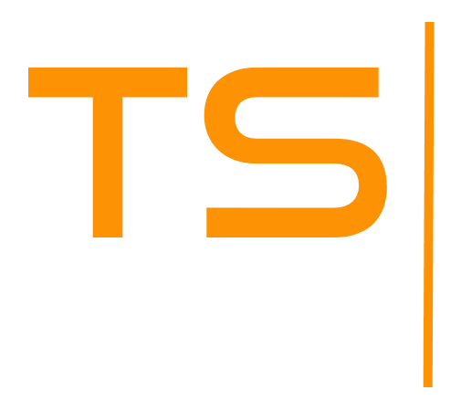
The OnLY Security Program Designed for Remote Access
DISCOVER
2025

Slide 2
SECURE
Protect your Remote Connections and Keep
your Servers Secure
2
15
USER FRIENDLY
Don’t Spend Time and Money Using different technologies.
Advanced Security has it all in one tool !
ECONOMIC

Slide 3
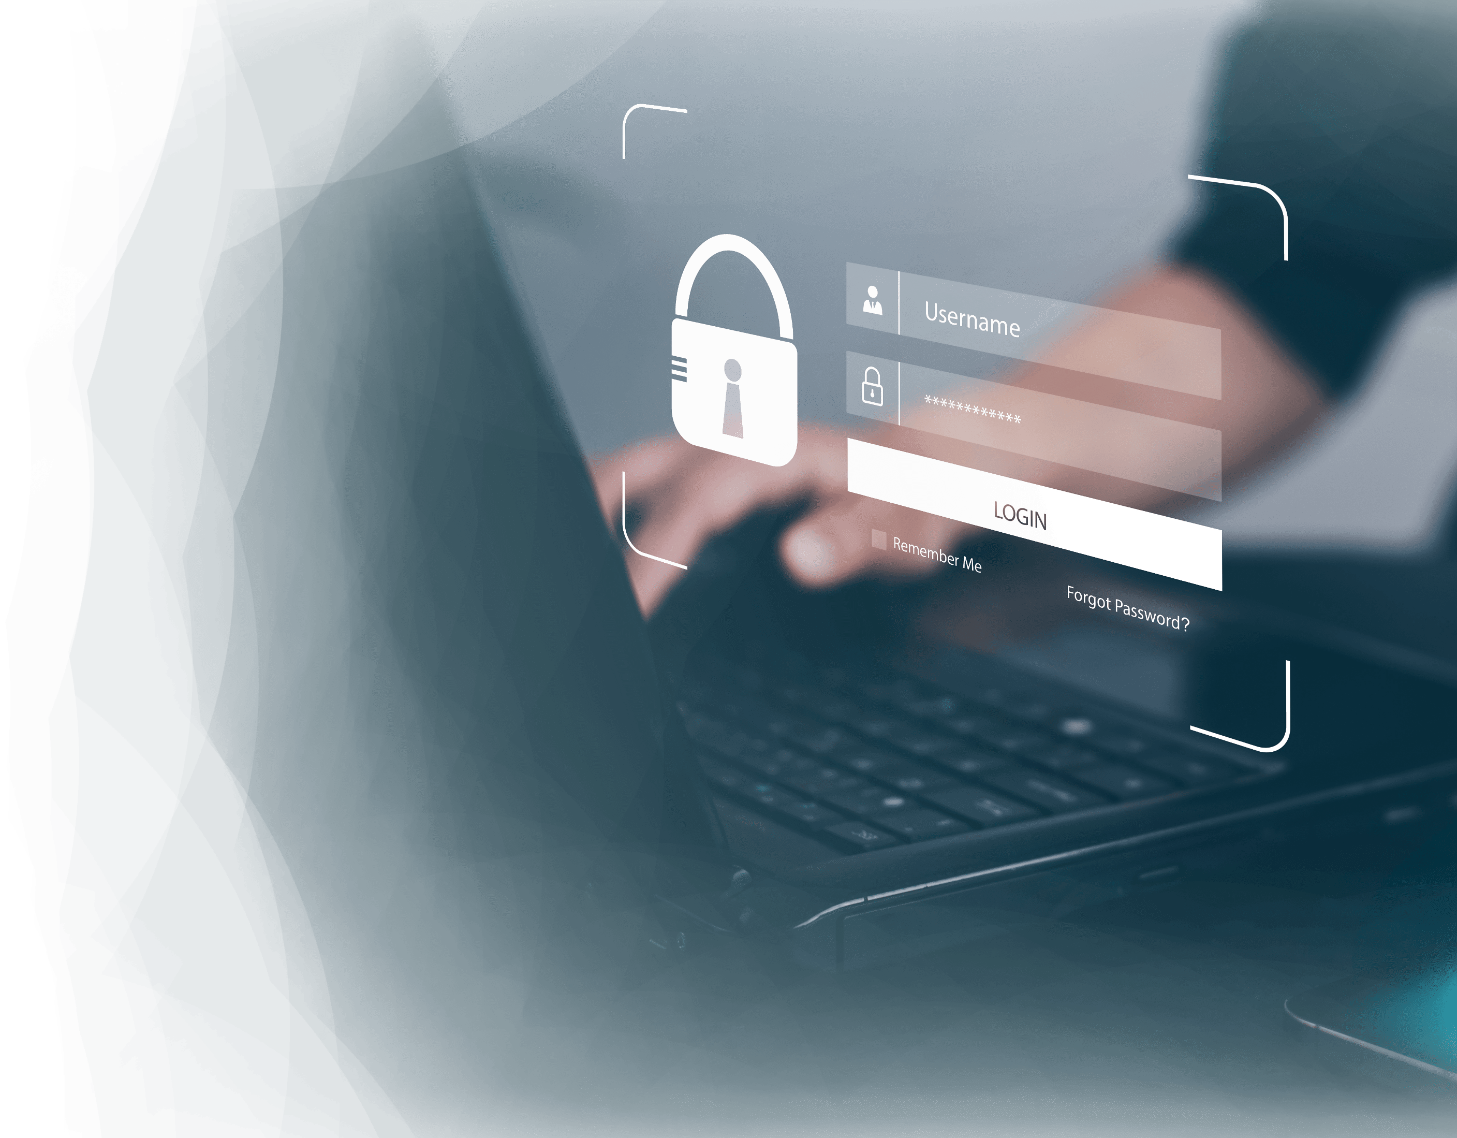
A Unique Tool for Remote Access Security
3
Full protection for Remote Desktop infrastructures
15
FIREWALL: Protect your network from external threats
SESSION SECURITY: Control user access
RANSOMWARE PROTECTION: Protect Corporate data

Slide 4
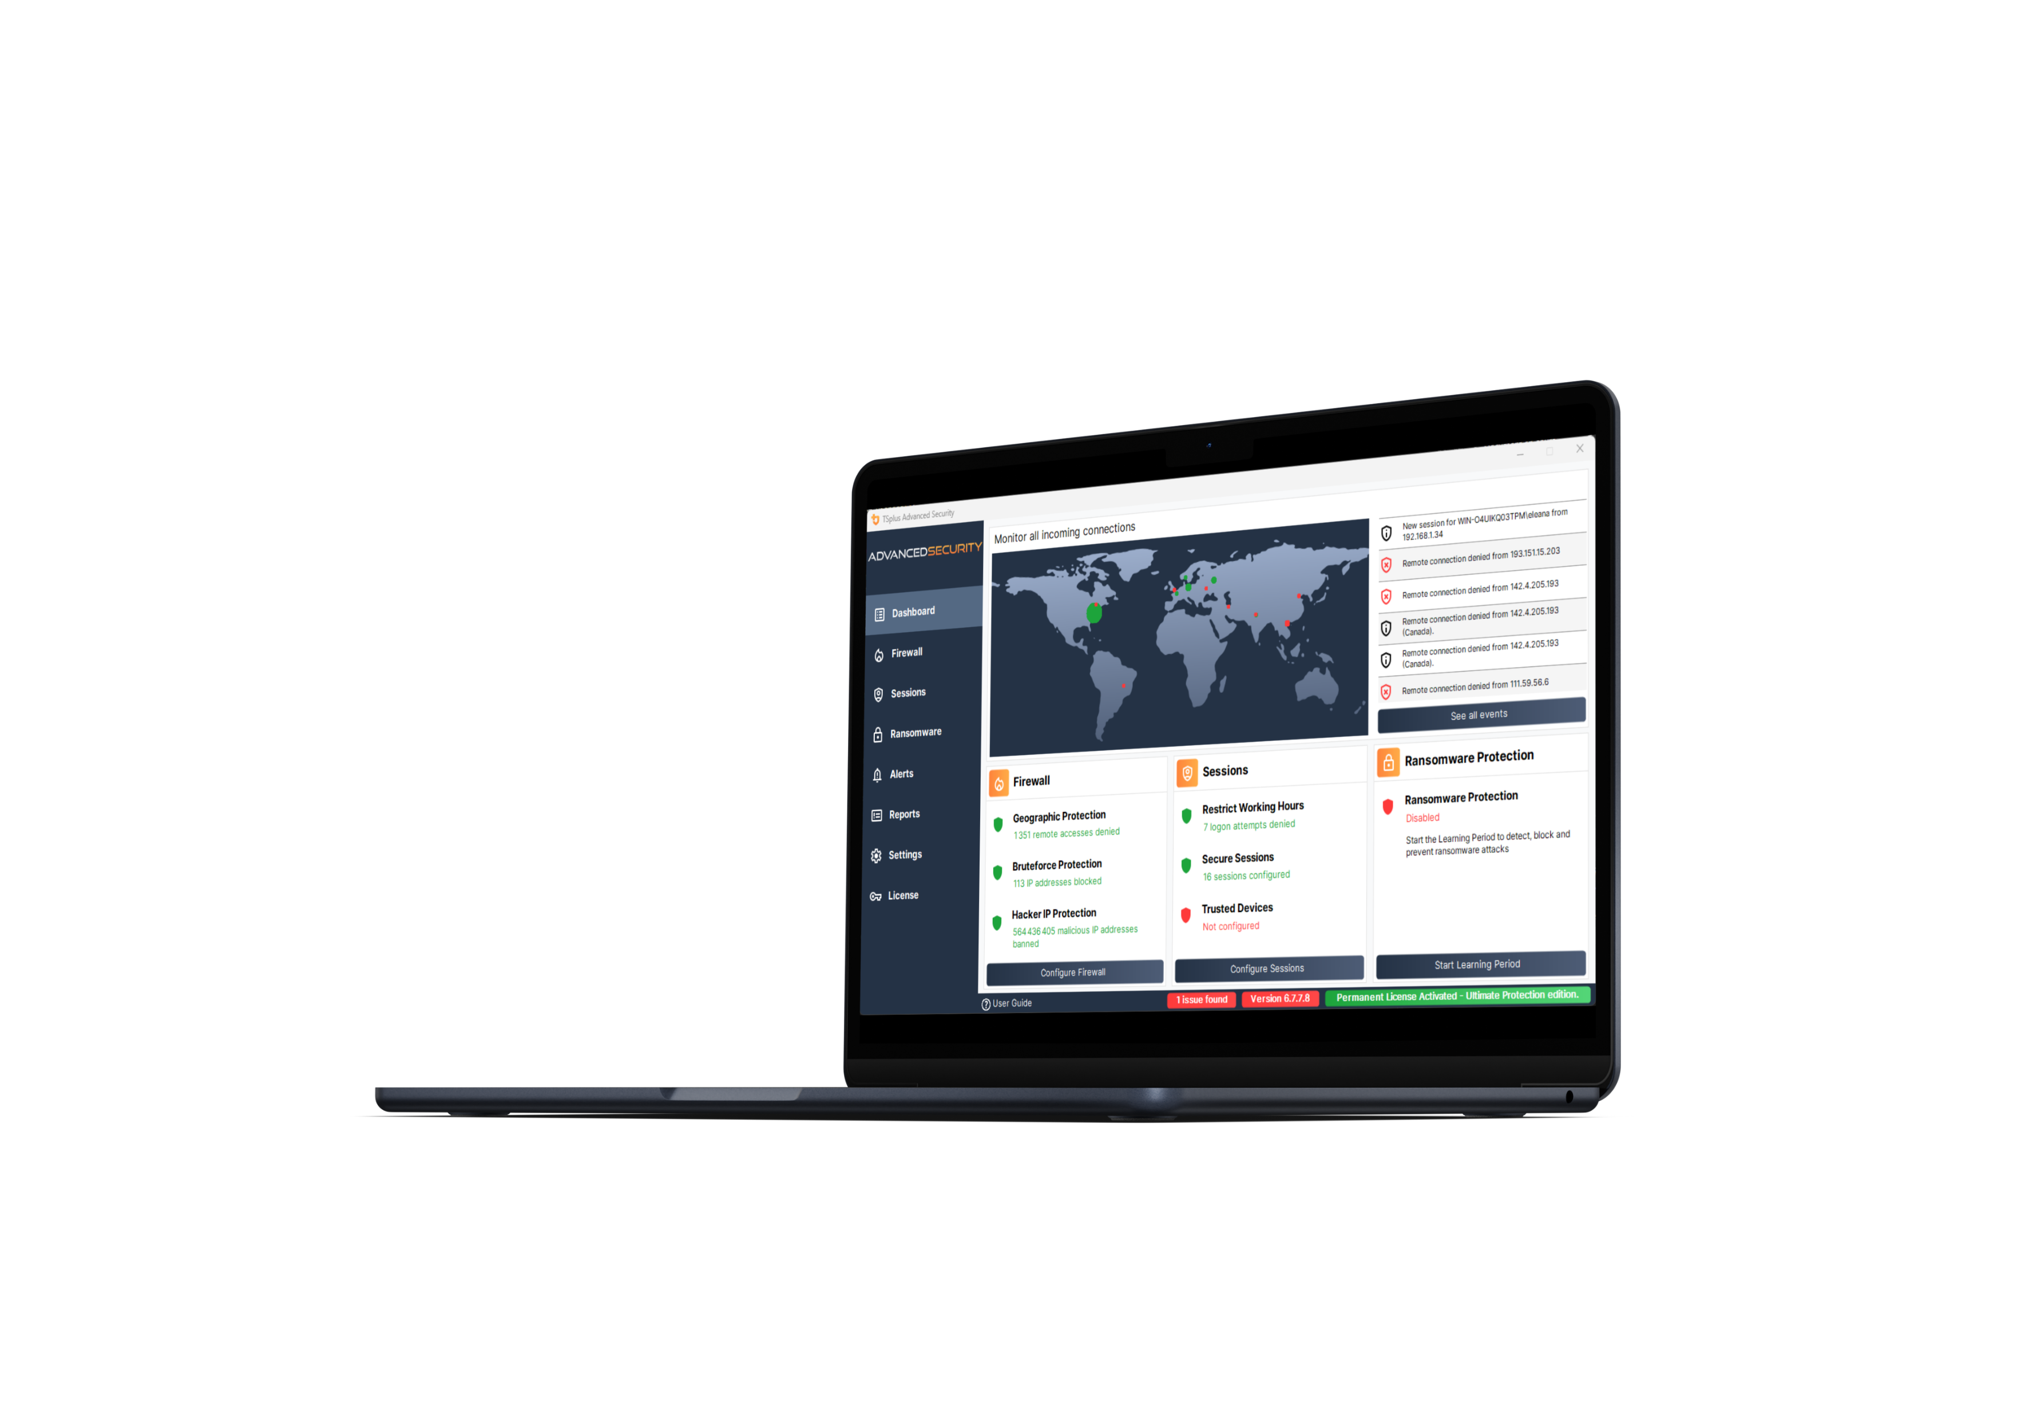
At Home or At the Office, Keep Your server Safe
Get All the ESSENTIAL Protections for Your Remote Desktop Servers!
4
GEOGRAPHIC PROTECTION
15
Allow Connections Based on Location
Block Connections from Anywhere else

Slide 5
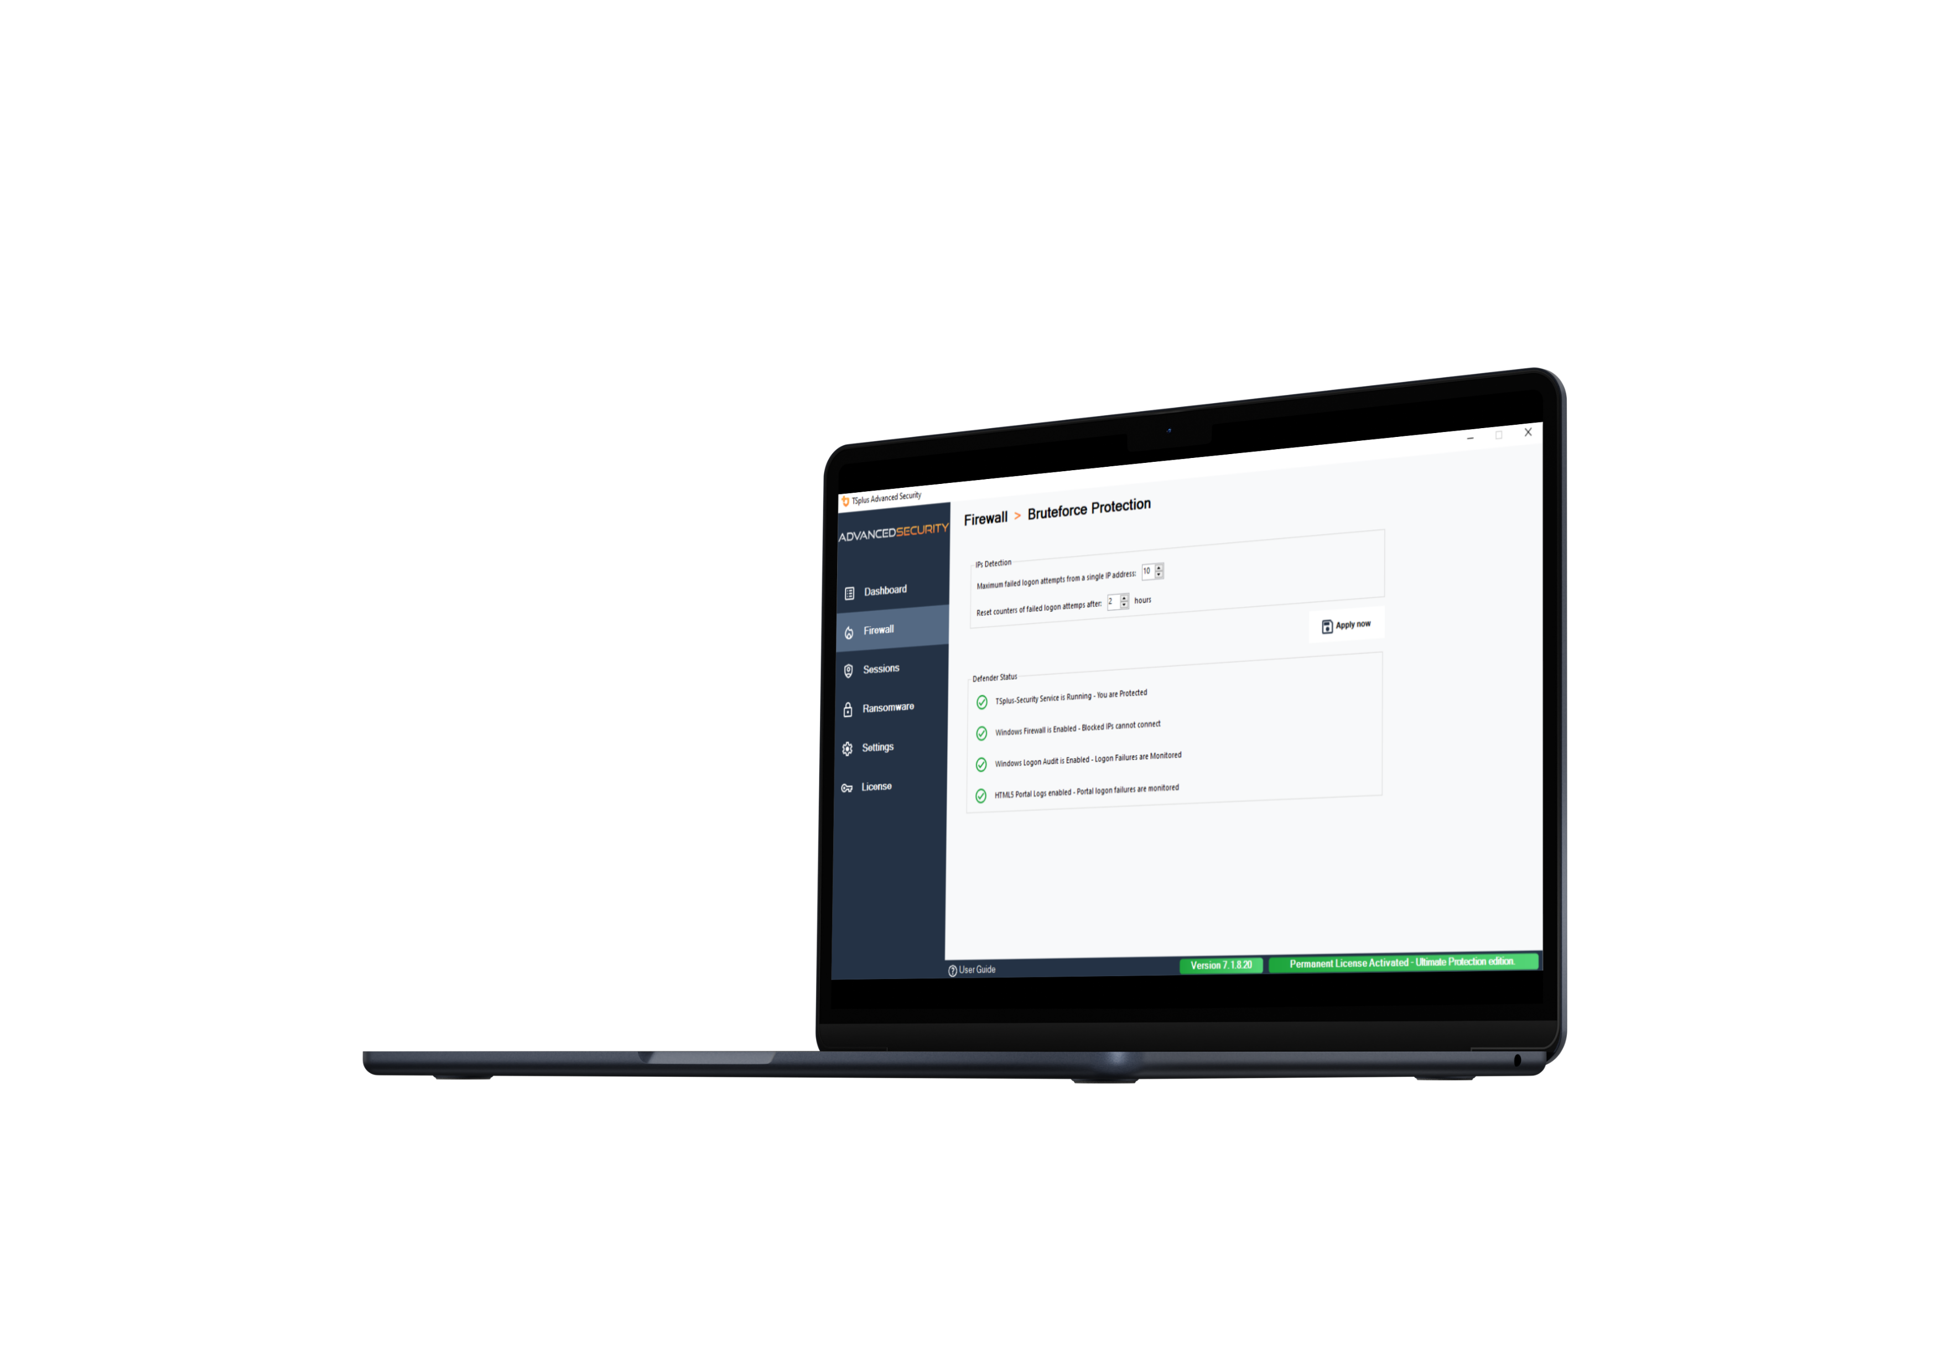
At Home or At the Office, Keep Your server Safe
Get All the ESSENTIAL Protections for Your Remote Desktop Servers!
5
BRUTE-FORCE PROTECTION
15
Detect Failed Connection Attempts
Block IP Addresses after Failed Attempts

Slide 6
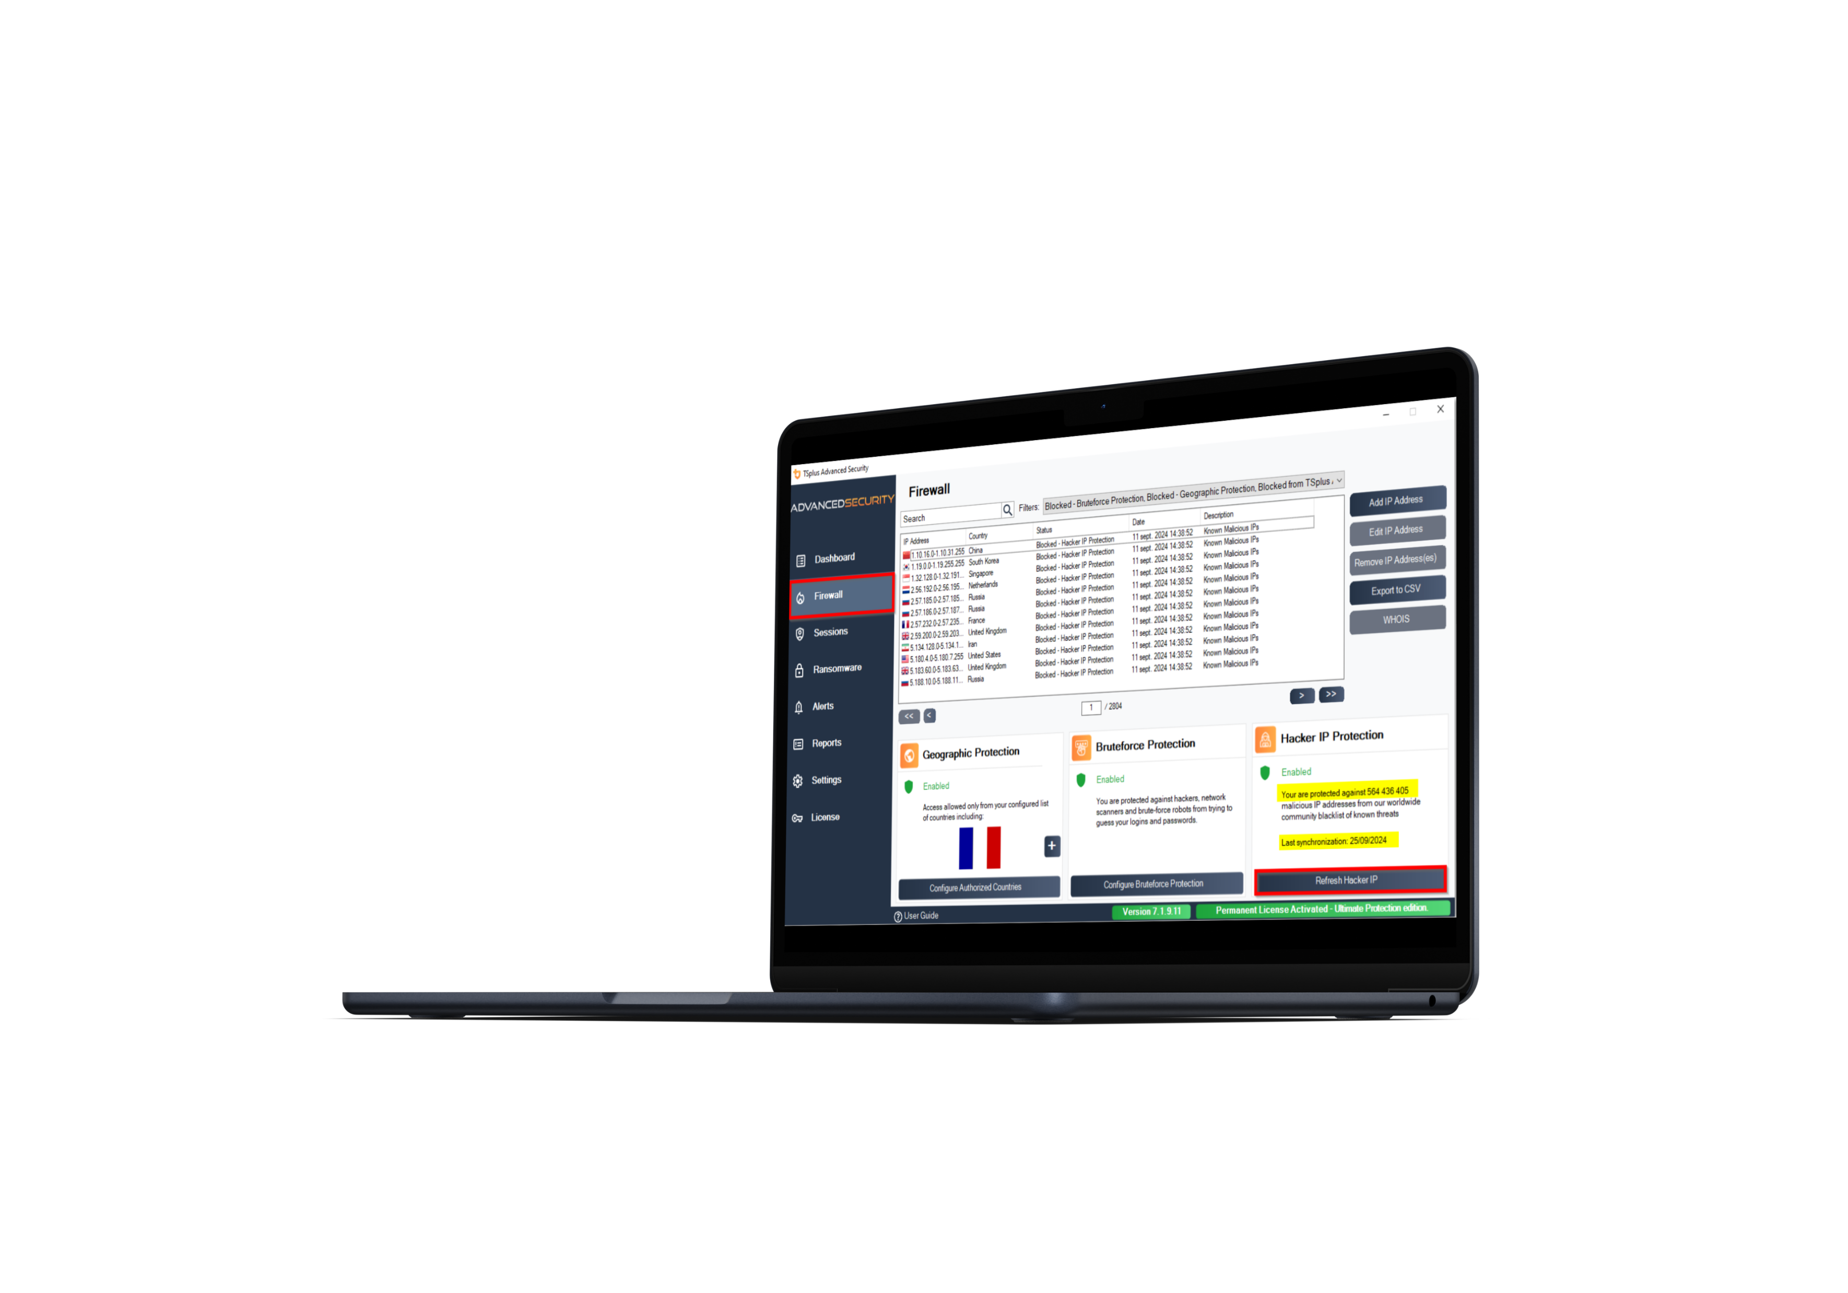
At Home or At the Office, Keep Your server Safe
Get All the ESSENTIAL Protections for Your Remote Desktop Servers!
6
Hacker IP PROTECTION
15
Protect Servers Against Hackers Attacks
Automatically Block More than 564 Millions Malicious IPs from Day 1

Slide 7
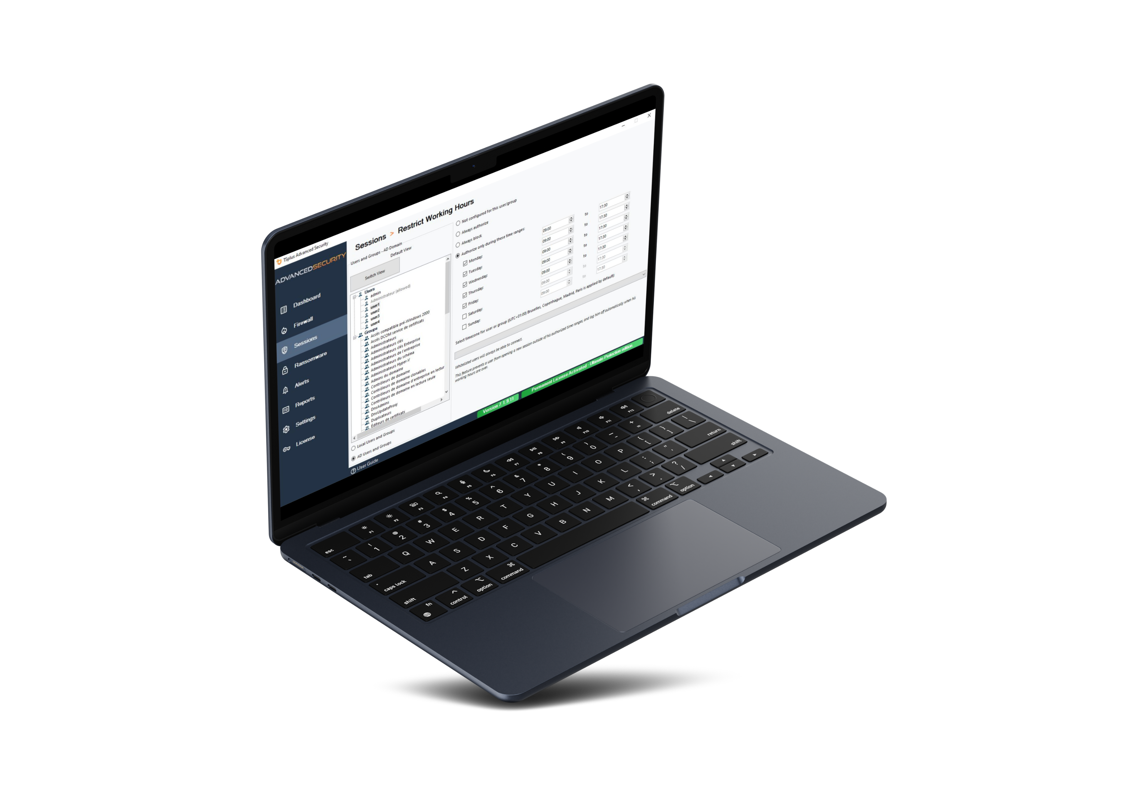
Lock down remote sessions and Increase your Peace of Mind
Get All the ESSENTIAL Protections for Your Remote Desktop Servers!
7
15
RestrICt Working hours
Set Working Hours per User/Group
Automatically Close Sessions and Prevent Logins Outside of Working Hours

Slide 8
Lock down remote sessions and Increase your Peace of Mind
Apply The ULTIMATE Security Rules to Protect Your Remote Environment
8
15
SECURE sessions
Set RDS Group Policy in One Click
Select from 3 Standard Security Levels

Slide 9
Lock down remote sessions and Increase your Peace of Mind
Apply The ULTIMATE Security Rules to Protect Your Remote Environment
9
15
PERMISSIONS MANAGEMENT
Inspect Windows User Permissions
Edit Permissions per User or Group

Slide 10
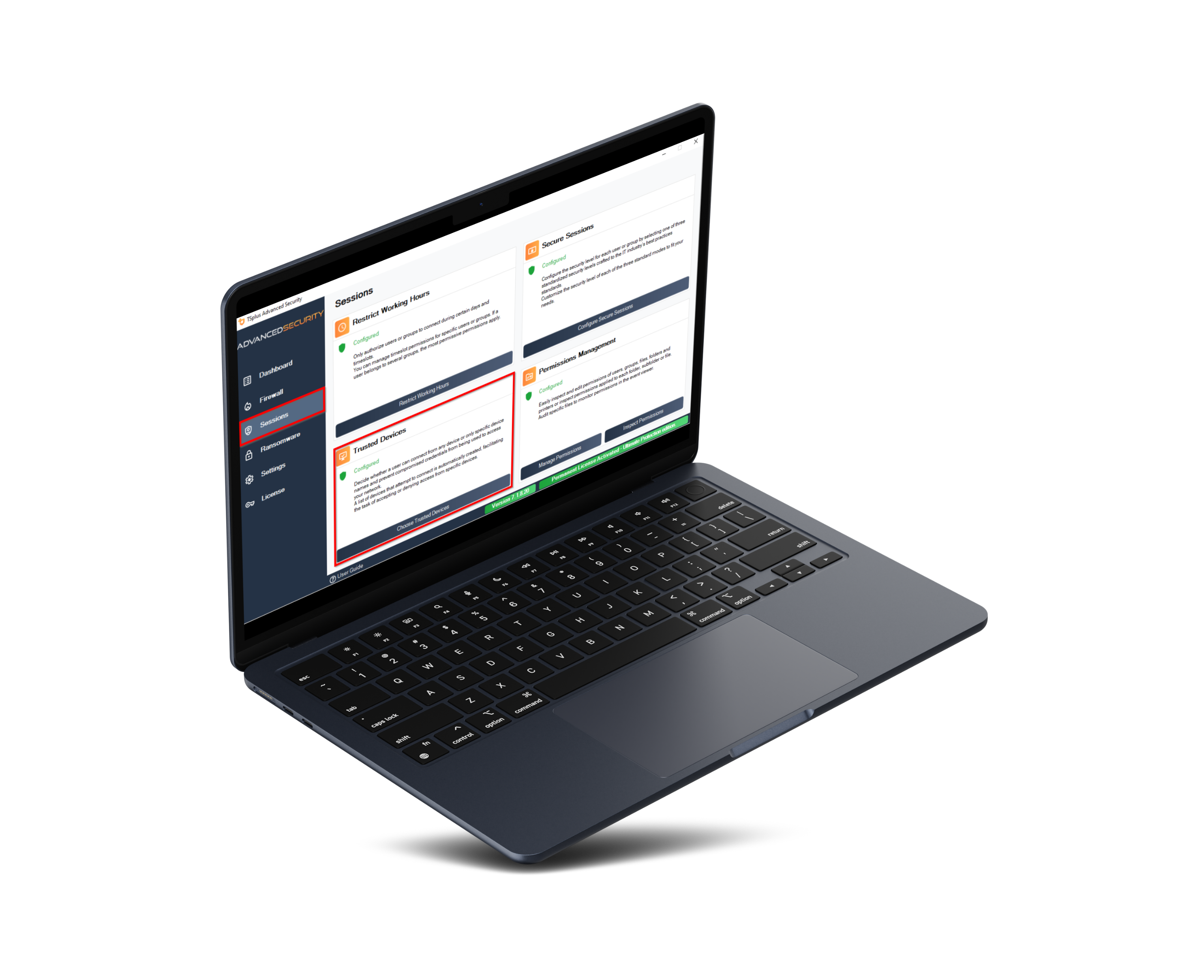
Lock down remote sessions and Increase your Peace of Mind
Apply The ULTIMATE Security Rules to Protect Your Remote Environment
10
15
Trusted devices
Control and Register Connecting Devices
Deny Access to Unauthorized Devices and get a List of Failed Attempts

Slide 11
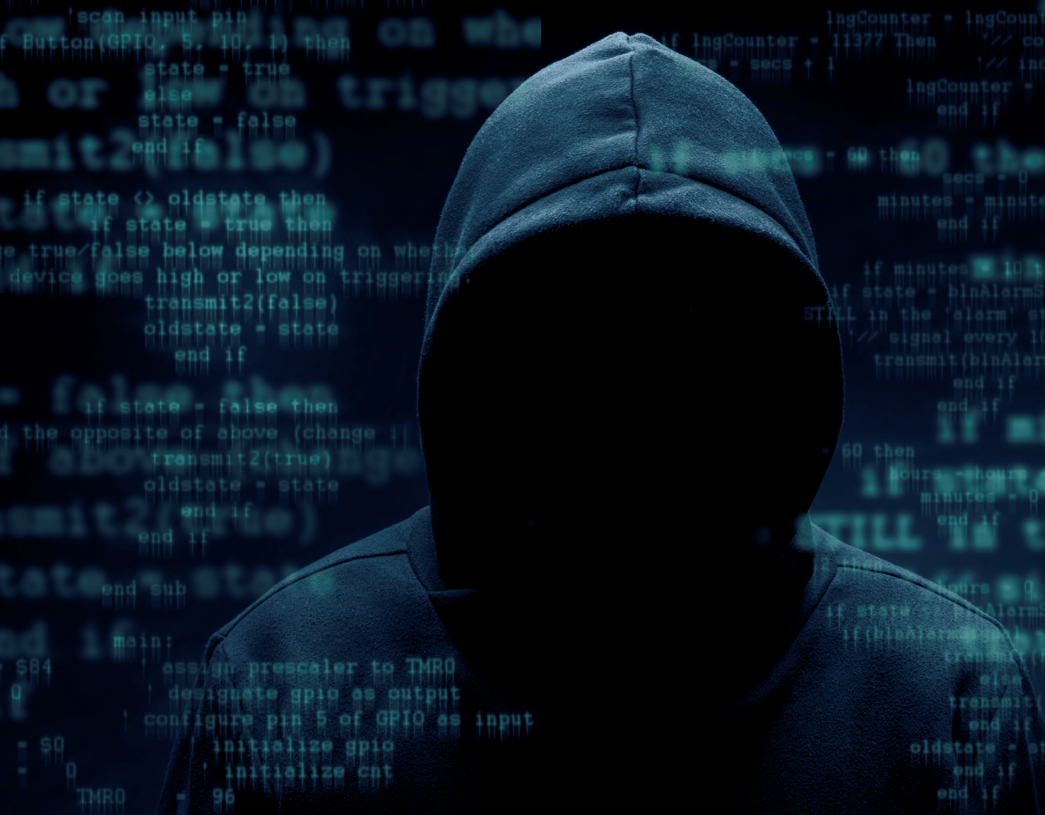
PROTECT YOUR SERVERS AND CORPORATE DATA
Apply The ULTIMATE Security Rules to Protect Your Remote Environment: RANSOMWARE PROTECTION
11
15
DETECT Ransomware Attacks
BLOCK Compromised Files
PREVENT By Analyzing Snapshots & Reports

Slide 12
All-in-One Cybersecurity Toolbox
Easily Manage The Level of Protection for Your Servers
12
15
Easy-to-use AdminTool
Central IP Addresses Management
Interactive Connections World Map
Real-Time Events Log
Alerts, Notifications and Reporting

Slide 13
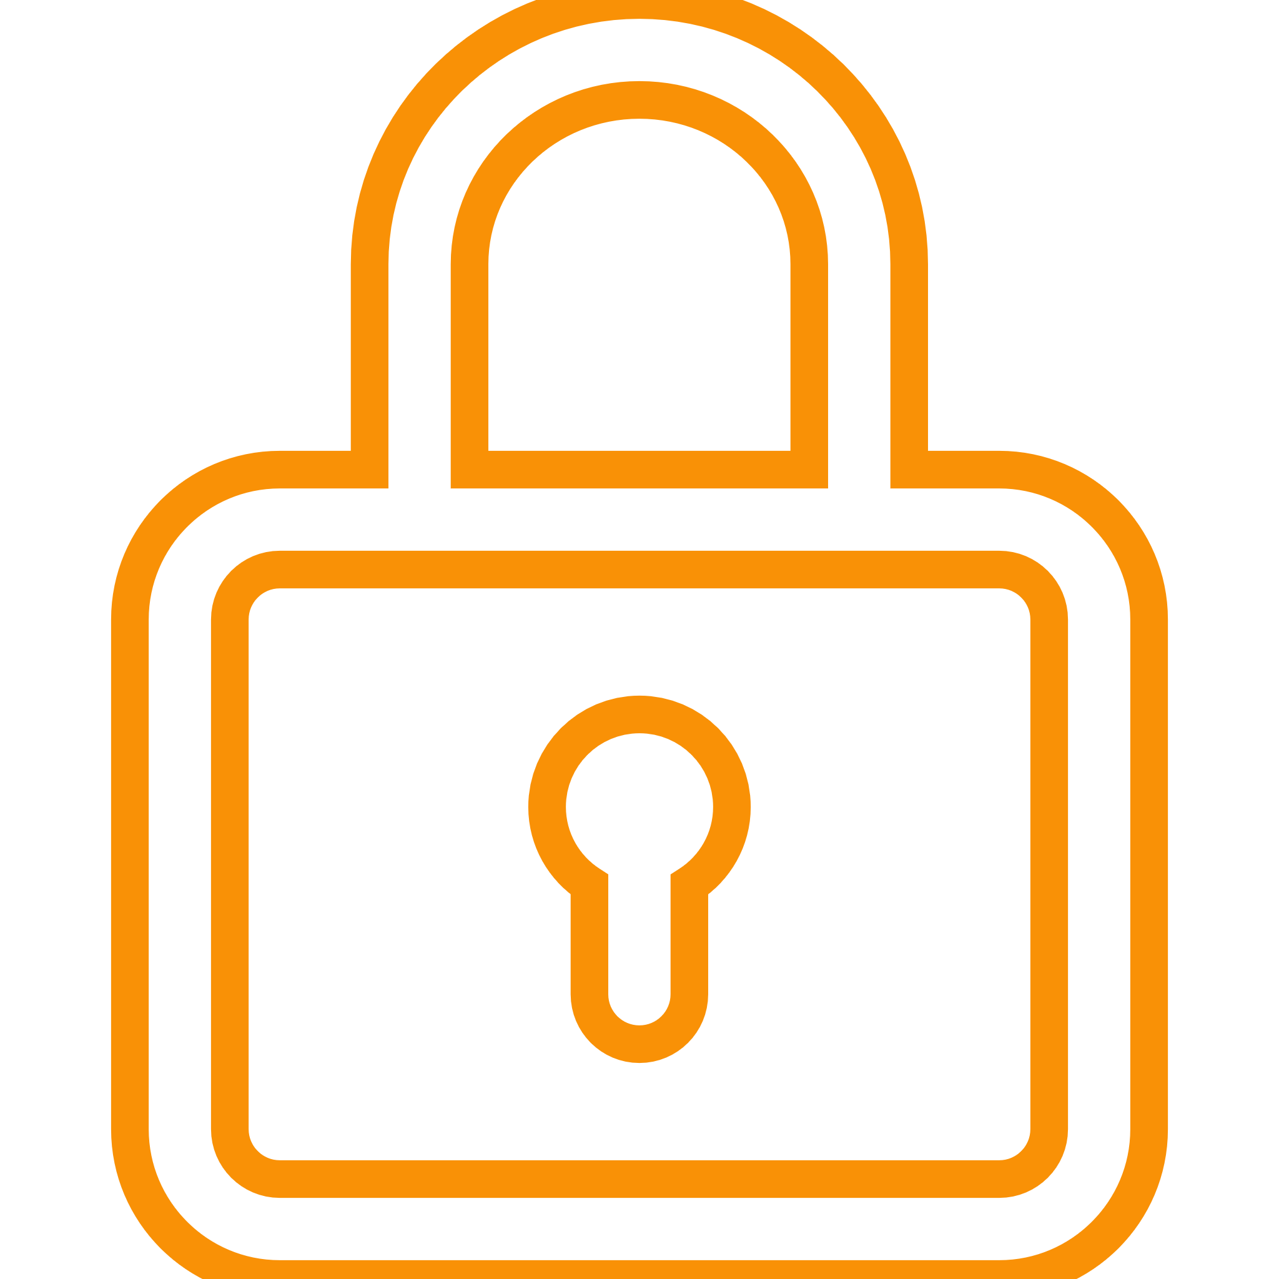
Prevent foreign spies
Stop
Ransomware
The TSplus Difference: A 360 degrees Approach to Security
13
Prevent, protect, defend
15
Advanced Security Prevents, Protects and Defends against all kinds of threats
Corporate Applications server
CONTROL ACCESS
SAFEGUARD YOUR DATA

Slide 14
Built for You: Flexible Licensing That Grows with Your Strategy!
Our very attractive licensing model starts, for the ESSENTIALS edition, at:
14
flexible
licensing
Per server
pricing
FREE TRIAL DOWNLOAD
15
$180
Per server – Perpetual
Or
Mix and match.
Protect Unlimited number of Clients
15 Days
$22
per server - Monthly
Buy and own your licenses forever or just rent them!
Test it Today!
Updates/Support included for a year
Visit our website

